Slide 1



NREGA Analysis report
Harith V Nambiar

Slide 2



agenda
Introduction ​
Problem Statement​
Data set Information
Summary​

Slide 3
introduction
This project delves into data analysis related to the National Rural Employment Guarantee Act (NREGA), a transformative government scheme aimed at providing rural households with guaranteed wage employment opportunities. The dataset used for this analysis encompasses many parameters, including the number of job cards issued, the workforce engaged, budget allocation, work completion statistics, and much more. Through data analytics techniques, we aim to gain valuable insights into the implementation and impact of NREGA across different states and districts in India.

Slide 4
Problem statement
NREGA is a vital initiative to alleviate rural unemployment and poverty. This project seeks to address several key questions and challenges associated with NREGA:
● How effective is NREGA in providing employment opportunities to rural households?
● Are there regional disparities in the implementation and outcomes of the scheme?
● What is the utilization of the allocated budget, and how does it correlate with employment generation?
● What are the key factors contributing to the completion of NREGA works, and are there any roadblocks to its success?
● Can data-driven insights guide policymakers and administrators in optimizing the scheme's impact?

Slide 5
Dataset description
● state_name
● district_name
● Total No. of JobCards issued
● Total No. of Workers
● Total No. of Active Job Cards
● Total No. of Active Workers
● SC workers against active workers
● ST workers against active workers
● Approved Labour Budget
● Persondays of Central Liability so far
● SC persondays
● ST persondays
● Women Persondays
● Average days of employment provided per Household
● Average Wage rate per day per person(Rs.)
● Total No of HHs completed 100 Days of Wage Employment
● Total Households Worked
● Total Individuals Worked
● Differently abled persons worked

Slide 6
Dataset description
● Number of GPs with NIL exp
● Total No. of Works Takenup (New+Spill Over)
● Number of Ongoing Works
● Number of Completed Works
● % of NRM Expenditure(Public + Individual):
● % of Category B Works
● % of Expenditure on Agriculture & Agriculture Allied Works
● Total Exp(Rs. in Lakhs.)
● Wages(Rs. In Lakhs)
● Material and skilled Wages(Rs. In Lakhs)
● Total Adm Expenditure (Rs. in Lakhs):

Slide 7
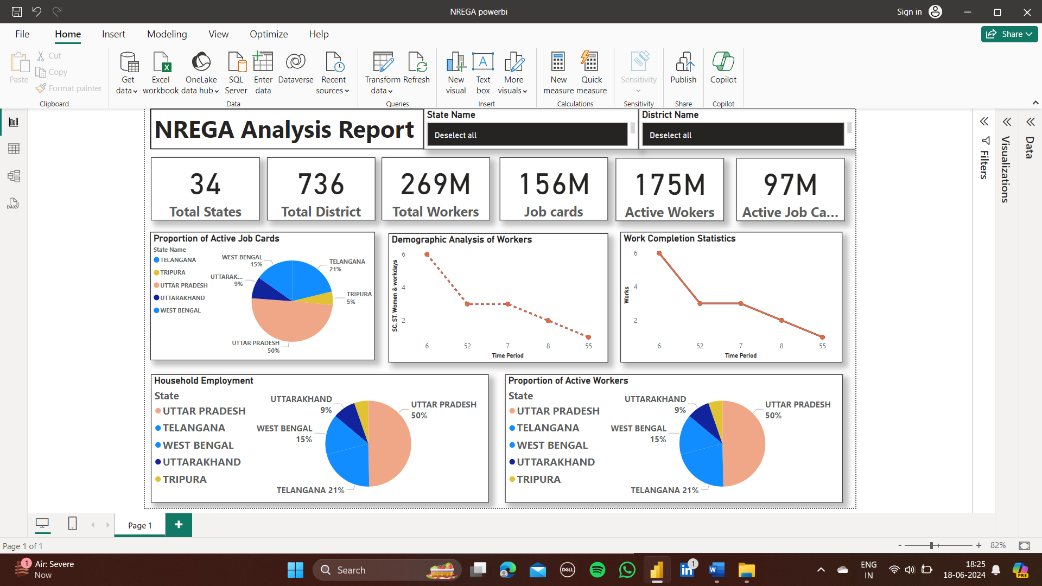

Slide 8

Thank you
HARITH V NAMBIAR
harithnambiar02@gmail.com​

